Slide 1
Diagrama Jack Knife
Procesos C1
EVC
2021

Slide 2
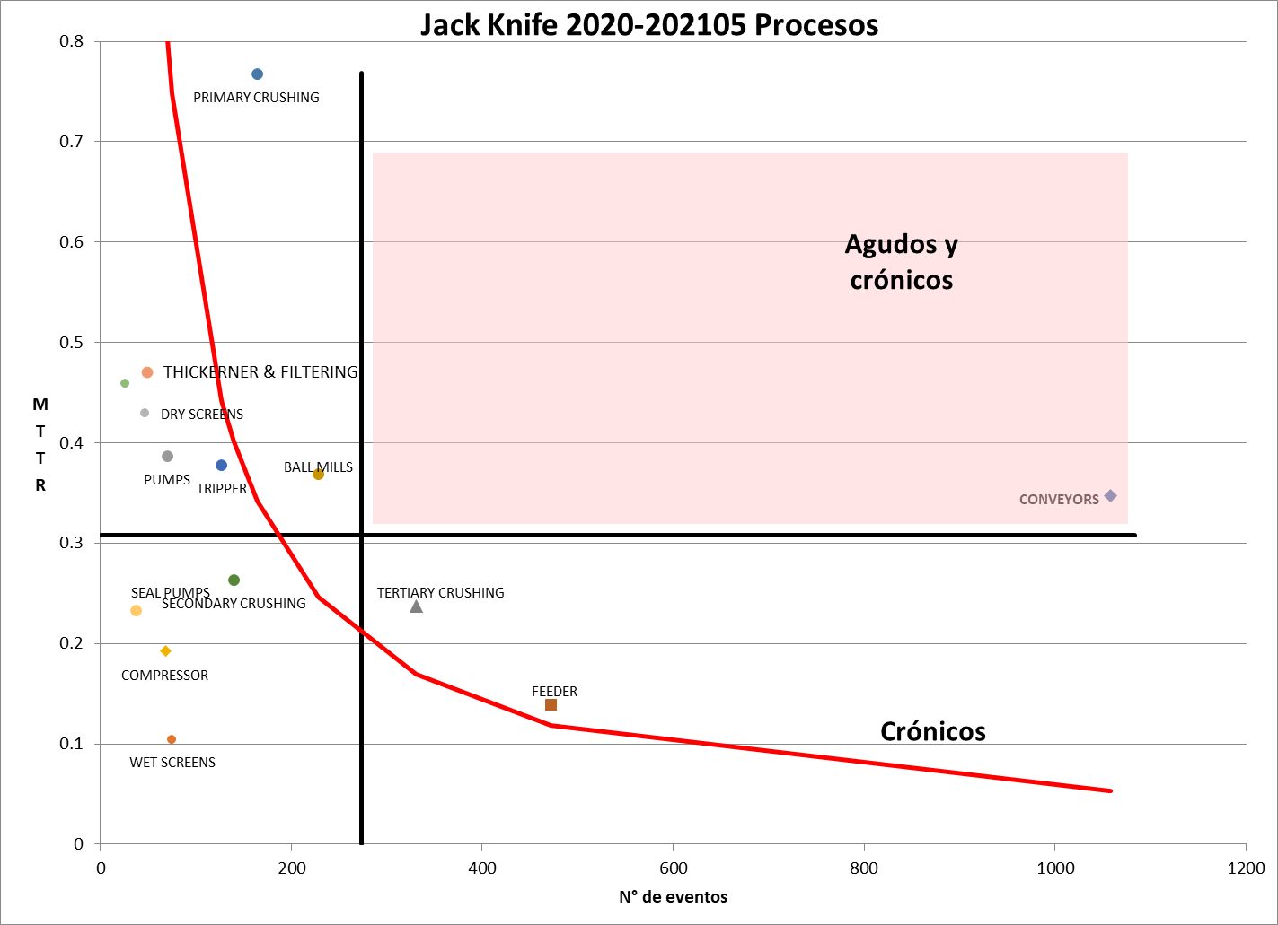
Jack Knife by C1 Processes
Overview. Each quadrant shows which processes have acute events, chronic events and acute & chronic events. “Conveyors” fleet have acute & chronic events.

Slide 3
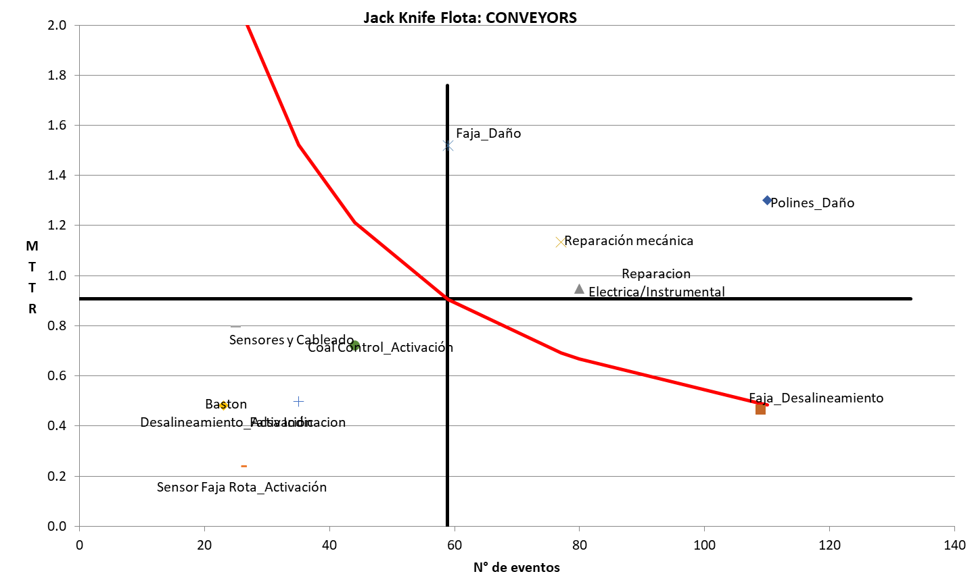
Jack Knife by C1 Fleet
Agudos y
crónicos
Crónicos

Slide 4
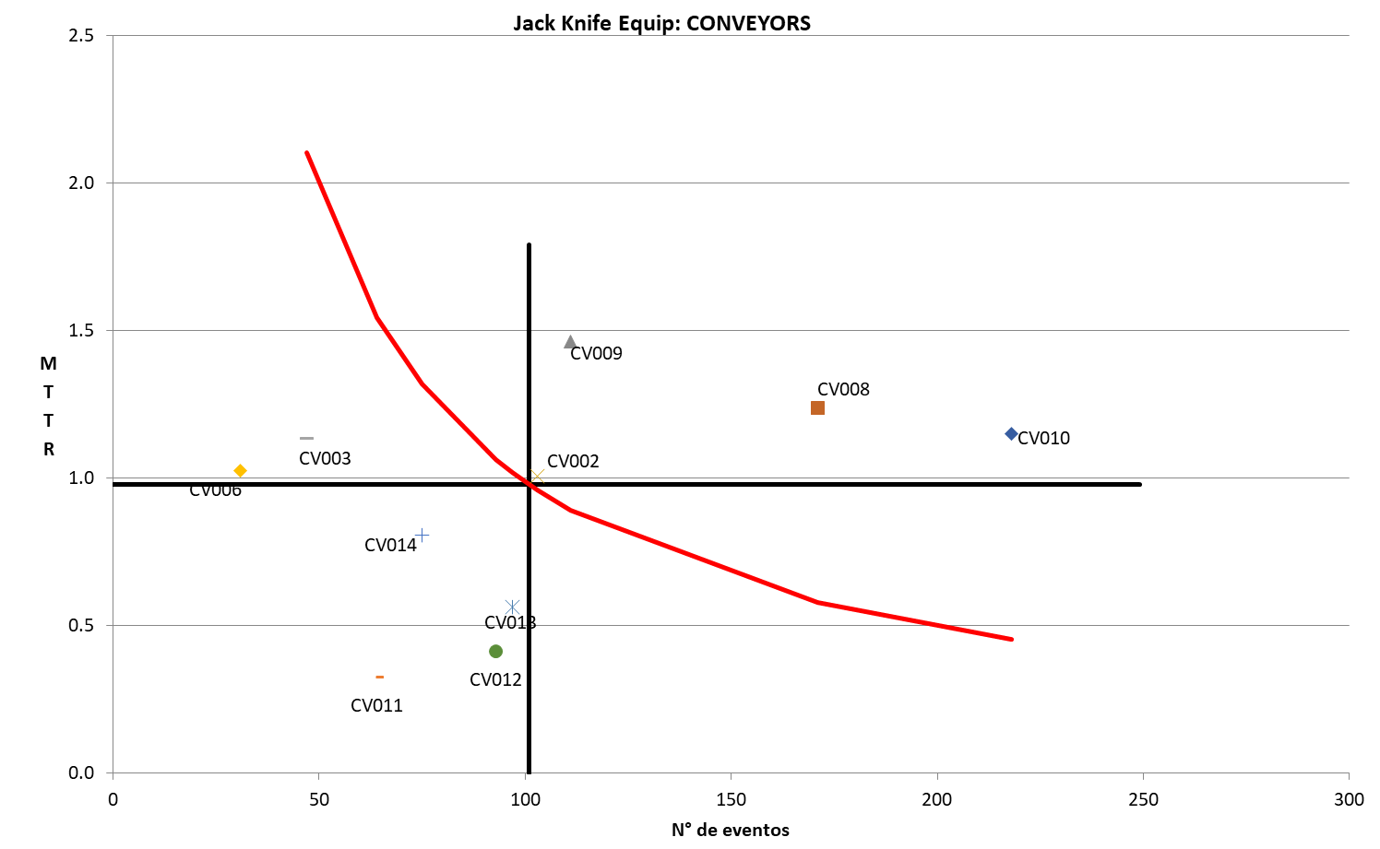
Jack Knife by C1 Equip
Review the “Faja” fleet with acute & chronic events, CV002, CV008, CV009 y CV010 show Acute and chronic events.
Agudos y
crónicos
Crónicos

Slide 5
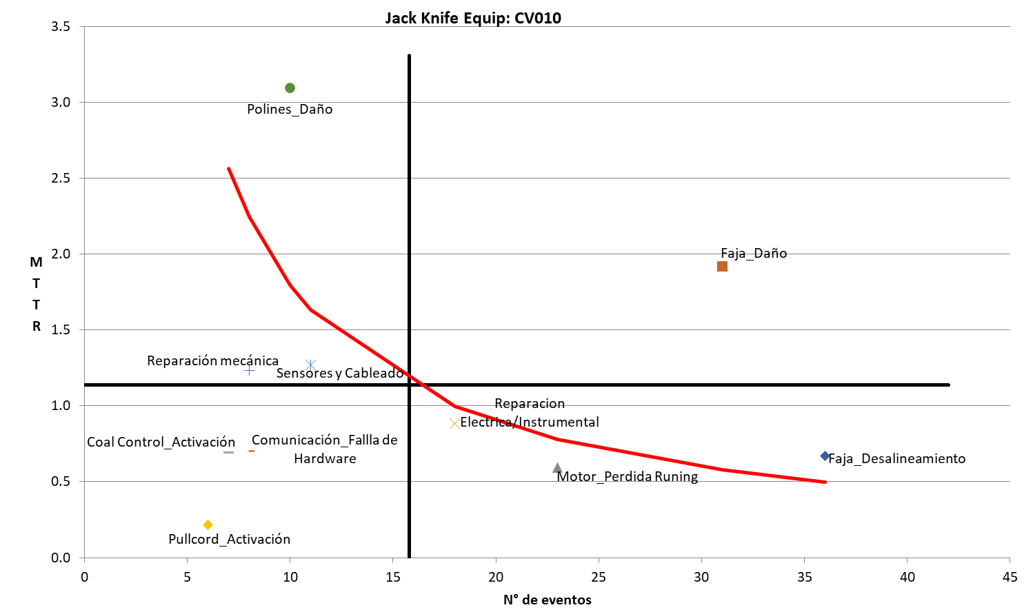
Jack Knife by piece of Equipment
Inside CV010 review which components are more critical according its location in the quadrants.
Agudos y
crónicos
Crónicos

